Slide 1

Geometry
Unit 2, Lesson 5 Conditionals and Biconditionals Volume 1, pg. 102

Slide 2


Benchmark
MA.912.LT.4.3
Identify and accurately interpret “if…then,” “if and only if,” “all” and “not” statements. Find the converse, inverse, and contrapositive of a statement.
volume 1, pg. 102

Slide 3
Integrated Mathematical Thinking and Reasoning Standards
MA.K12.MTR.1.1 Actively participate in effortful learning both individually and collectively.
MA.K12.MTR.4.1 Engage in discussions that reflect on the mathematical thinking of self and others.
MA.K12.MTR.5.1 Use patterns and structure to help understand and connect mathematical concepts.
MA.K12.MTR.6.1 Assess the reasonableness of solutions.
volume 1, pg. 102

Slide 4

Learning Targets
I can write the converse, inverse, and contrapositive of a mathematical statement.
I can determine if a statement is biconditional.
I can write a definition as a biconditional.
volume 1, pg. 102

Slide 5

Warm-Up
volume 1, pg. 102

Slide 6
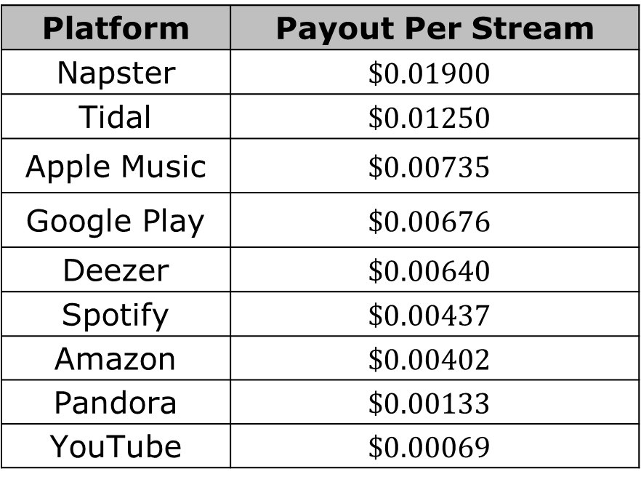
2.5.1 Warm-Up: Streaming Payouts
The payouts to a musician for each time a song is streamed on multiple streaming platforms in 2019 is shown.
Platform | Payout Per Stream
Napster | $$\$0.01900$$
Tidal | $$\$0.01250$$
Apple Music | $$\$0.00735$$
Google Play | $$\$0.00676$$
Deezer | $$\$0.00640$$
Spotify | $$\$0.00437$$
Amazon | $$\$0.00402$$
Pandora | $$\$0.00133$$
YouTube | $$\$0.00069$$
volume 1, pg. 102

Slide 7
Determine the payout for a musician whose song was streamed 100,000 times on each platform.
How many streams on Spotify did it take to for a musician to make $1 in 2019?
Platform | Payout for 100,000 Streams (in dollars)
Napster
Tidal
Apple Music
Google Play
Deezer
Spotify
Amazon
Pandora
YouTube
volume 1, pg. 102

Slide 8

Activity
volume 1, pg. 103

Slide 9

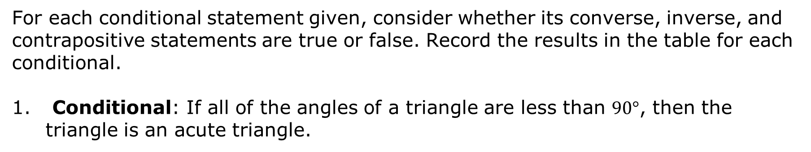
2.5.2 Activity: True or False
For each conditional statement given, consider whether its converse, inverse, and contrapositive statements are true or false. Record the results in the table for each conditional.
Conditional: If all of the angles of a triangle are less than $90°$, then the triangle is an acute triangle.
Relationship to Conditional | True or False
Converse
Inverse
Contrapositive
volume 1, pg. 103

Slide 10
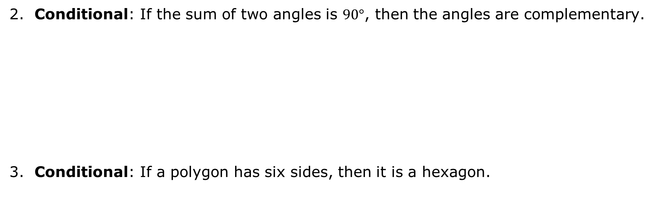
Conditional: If the sum of two angles is $90°$, then the angles are complementary.
Conditional: If a polygon has six sides, then it is a hexagon.
Relationship to Conditional | True or False
Converse
Inverse
Contrapositive
Relationship to Conditional | True or False
Converse
Inverse
Contrapositive
volume 1, pg. 103

Slide 11
Conditional: If a line or ray divides an angle into two equal angles, then the line or ray is the bisector of the angle.
Conditional: If lines that lie on the same plane do not intersect, then the lines are parallel.
Relationship to Conditional | True or False
Converse
Inverse
Contrapositive
Relationship to Conditional | True or False
Converse
Inverse
Contrapositive
volume 1, pg. 103

Slide 12

Conditional: If the opposite sides of a quadrilateral are parallel, then the quadrilateral is a parallelogram.
Conditional: If $\vec{XY}$ is in the interior of $∠WXZ$, then $m∠WXY+m∠YXZ=m∠WXZ$.
Relationship to Conditional | True or False
Converse
Inverse
Contrapositive
Relationship to Conditional | True or False
Converse
Inverse
Contrapositive
volume 1, pg. 103

Slide 13
Conditional: If two planes intersect, then their intersection is exactly one line.
Conditional: If two lines have the same slope, then they are parallel.
Relationship to Conditional | True or False
Converse
Inverse
Contrapositive
Relationship to Conditional | True or False
Converse
Inverse
Contrapositive
volume 1, pg. 104

Slide 14

Bring It Together
volume 1, pg. 104

Slide 15

2.5.3 Bring It Together: Biconditionals
How many of the conditionals from the previous Activity were considered true for all of the statements — converse, inverse, and contrapositive?
For how many conditionals was the converse of the conditional considered true?
volume 1, pg. 104

Slide 16


A conditional statement is considered biconditional when both the statement and its converse are true. In other words, if both directions of the statement are true – “If $P$, then $Q$” and “If $Q$, then $P$” – the statement is biconditional.
Biconditional statements can be written in the format of “if and only if.”
A definition is an exact statement, written formally, of the meaning or description of a word. Even though definitions in mathematics are often written as conditional statements, all definitions are actually biconditional statements.
volume 1, pg. 105

Slide 17
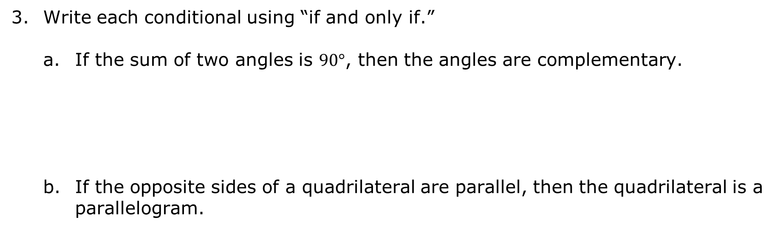
Write each conditional using “if and only if.”
If the sum of two angles is $90°$, then the angles are complementary.
If the opposite sides of a quadrilateral are parallel, then the quadrilateral is a parallelogram.
volume 1, pg. 105

Slide 18

Your Turn
volume 1, pg. 105

Slide 19
2.5.4 Your Turn!
Complete the table for the conditional statement.
If all four angles at the point of intersection of two lines are right angles, then the lines are perpendicular.
Relationship to Conditional | Statement | True or False
Converse
Inverse
Contrapositive
volume 1, pg. 105

Slide 20
Explain why the conditional statement is biconditional.
Write the conditional using “if and only if.”
volume 1, pg. 105

Slide 21

Wrap-Up
volume 1, pg. 106

Slide 22
2.5.5 Wrap-Up: Reflection
Place an X on the circle that shows what you learned or completed during today’s lesson.
 | I am confident I know how to do this! | OR | I always did this!
 | I am fairly sure I know how to do this. | OR | I tried this.
 | I need support on this. | OR | I had trouble with this.
volume 1, pg. 106

Slide 23
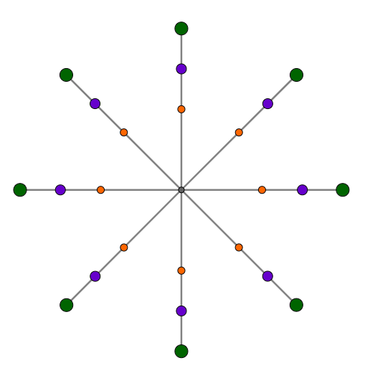
Writing a contrapositive
Writing an example
Writing an inverse
Asked questions
Correcting my mistakes
Writing a converse
Writing a counterexample
Writing a biconditional
volume 1, pg. 106

